Slide 1
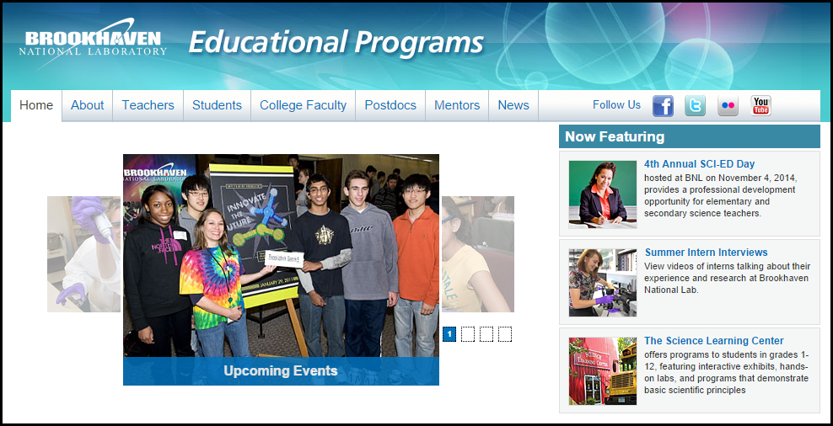
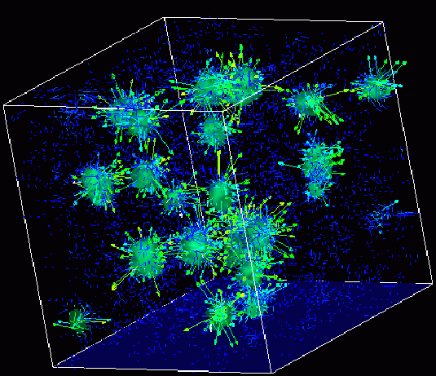

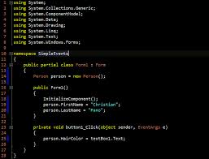
Advanced
Scientific Computing
(SciComp 201)
Session 06
Graphing with ROOT, Sampling Theory

Slide 2
Seminar Goals
Understand the history and motivation for CERN developing ROOT – A Data Analysis Framework
Review how to link the ROOT libraries into a Visual Studio C++ application
Create a ROOT line graph from a sinusoid
Appreciate the affect of sampling rate on aliasing
Create a ROOT histogram of a Gaussian normal distribution

Slide 3




Slide 4
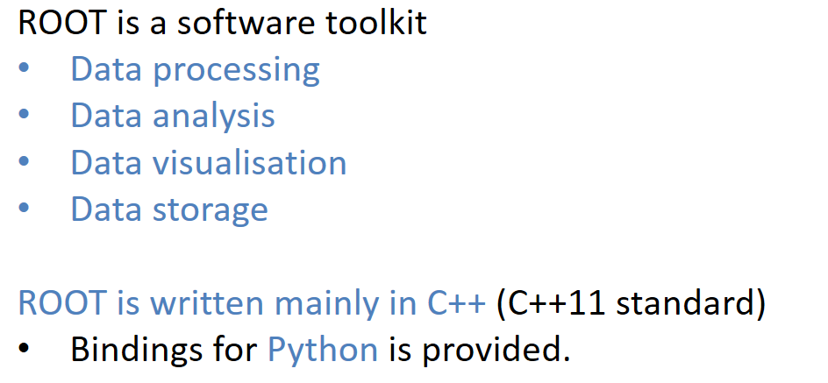
https://root.cern.ch

Slide 5
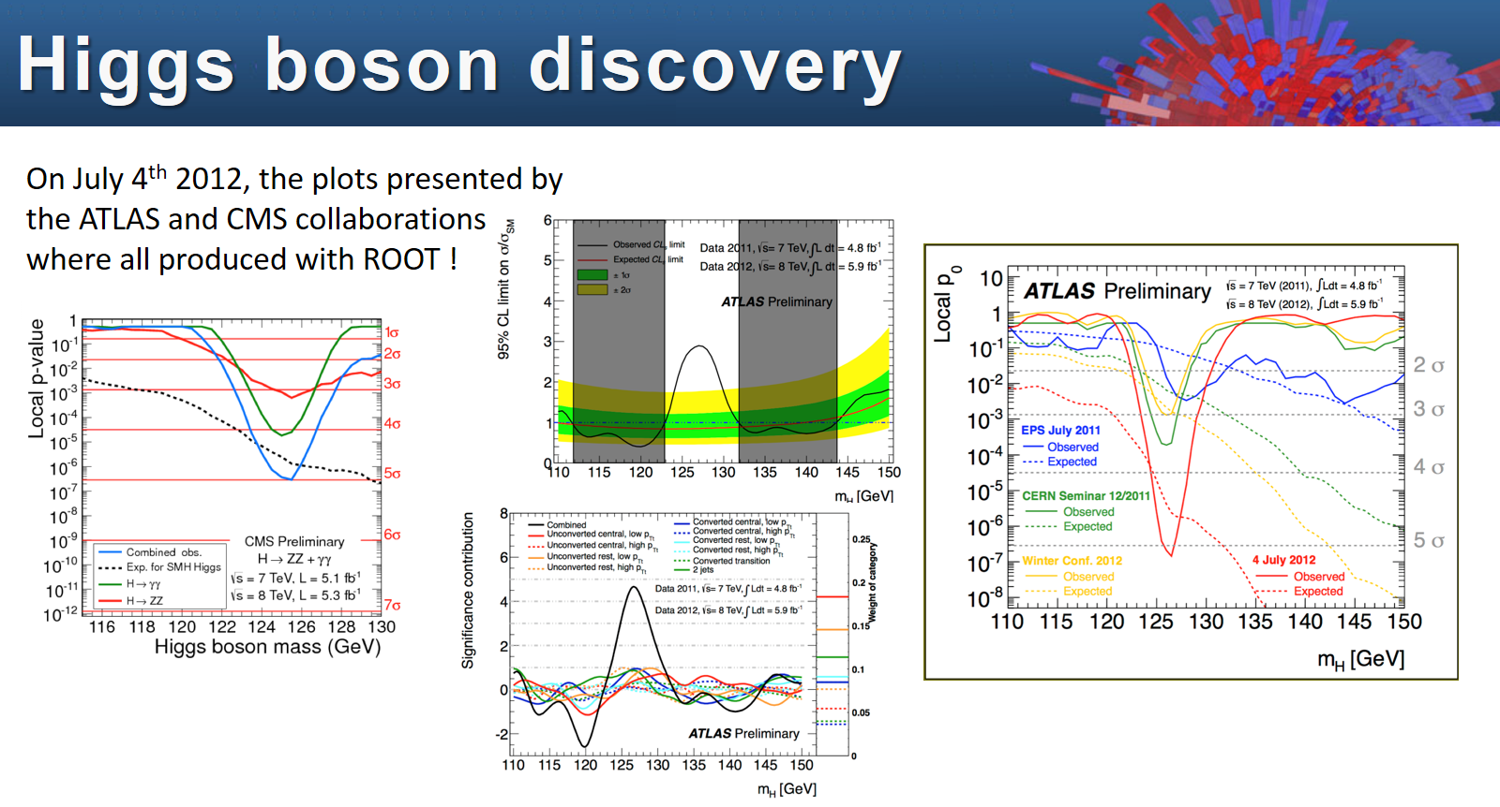

Slide 6
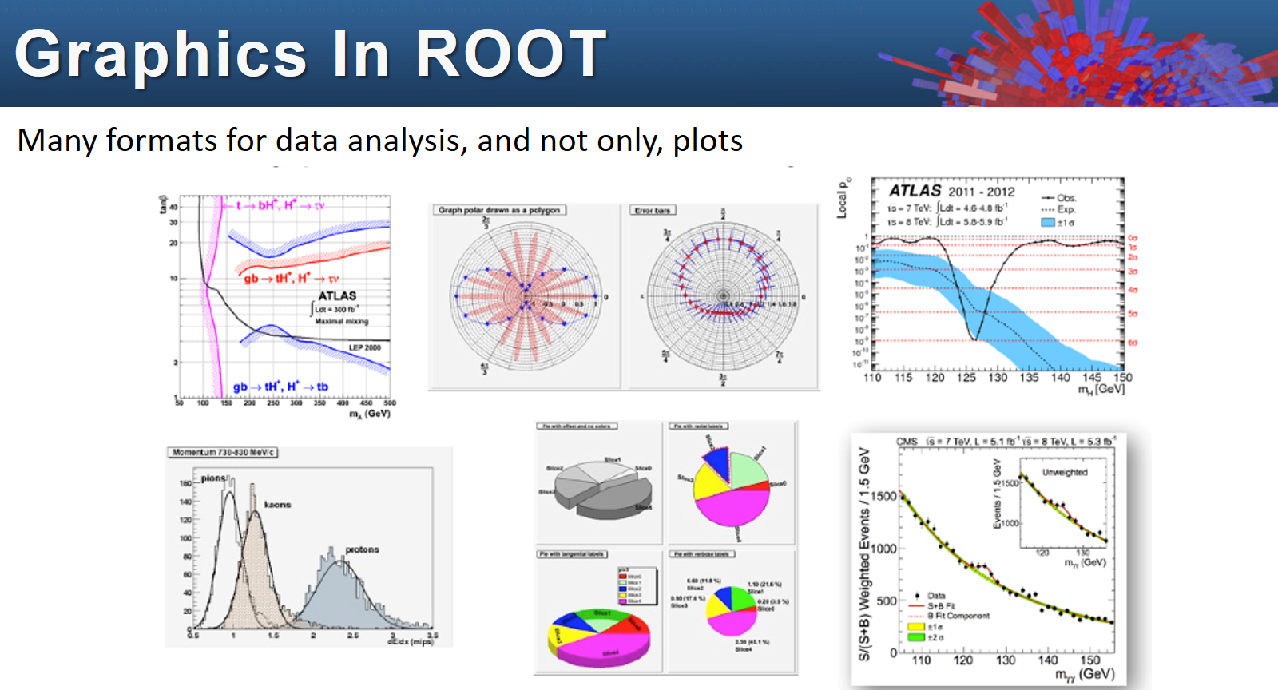

Slide 7
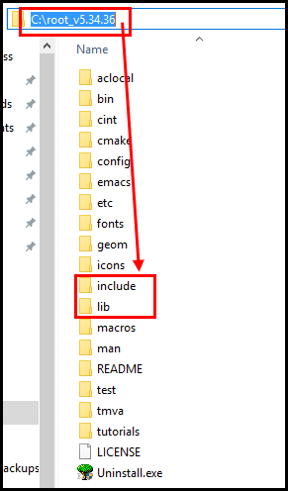
Leveraging ROOT
ROOT is already installed in your Amazon PC in the root folder of C:\
We will be using Root v5.34.36 – the most current version of Root is v6.1 but that is not yet compatible with Visual Studio 2015

Slide 8
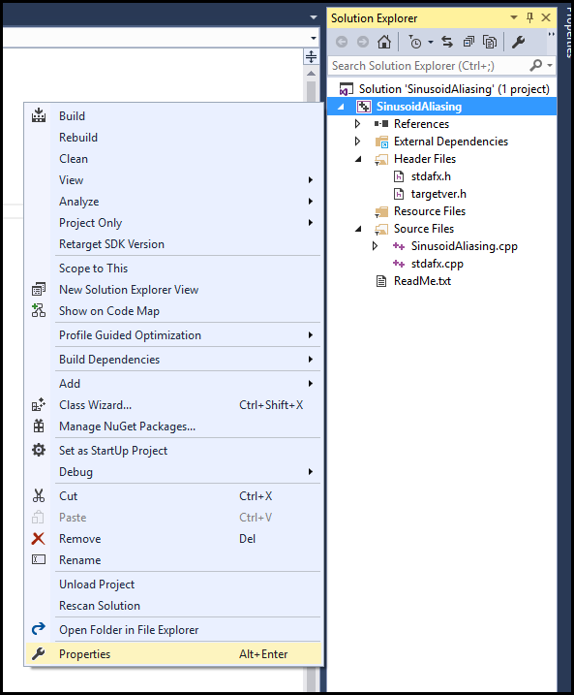
Leveraging ROOT
We must tell the compiler where to find the ROOT header files (.h)
We must tell the linker where to find the ROOT libraries (.lib)
Right click on the project node in Solution Explorer, then select Properties

Slide 9
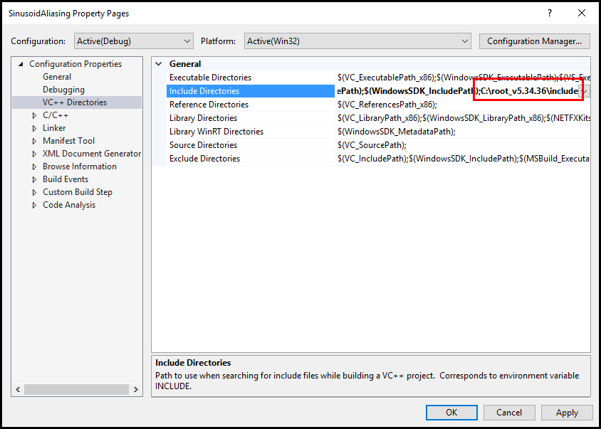
Leveraging ROOT

Slide 10
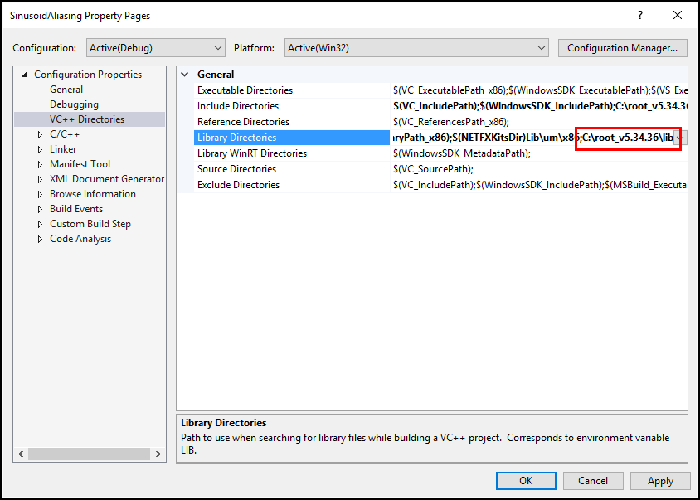
Leveraging ROOT

Slide 11
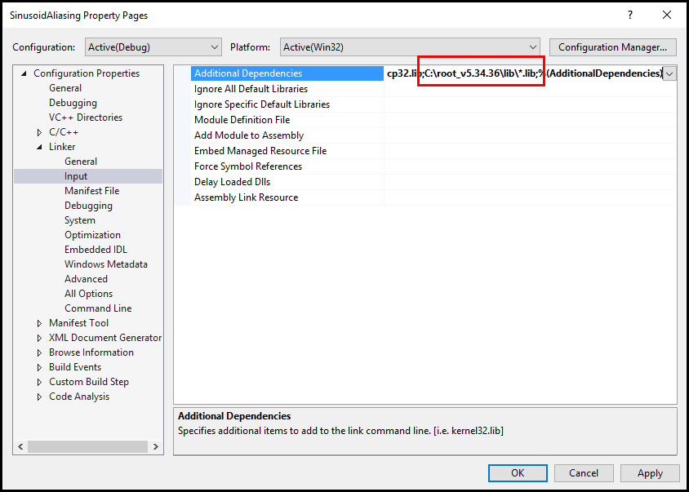
Leveraging ROOT
C:\root_v5.34.36\lib\*.lib;

Slide 12
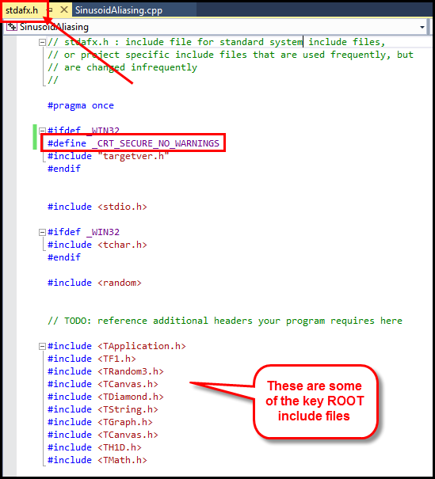
Leveraging ROOT

Slide 13
ROOT and OOP
ROOT is an object-oriented framework
Core capabilities are organized into hierarchy
ROOT custom data types all start with a capital T
TApplication, TCanvas, TGraph, TFunction, THistogram
Note: ROOT uses “pointers” and the new() operator to construct objects on the heap
Pointers have an asterisk * after the type name before the variable name
Calling methods on the object that a pointer “points to” is done using the -> operator

Slide 14
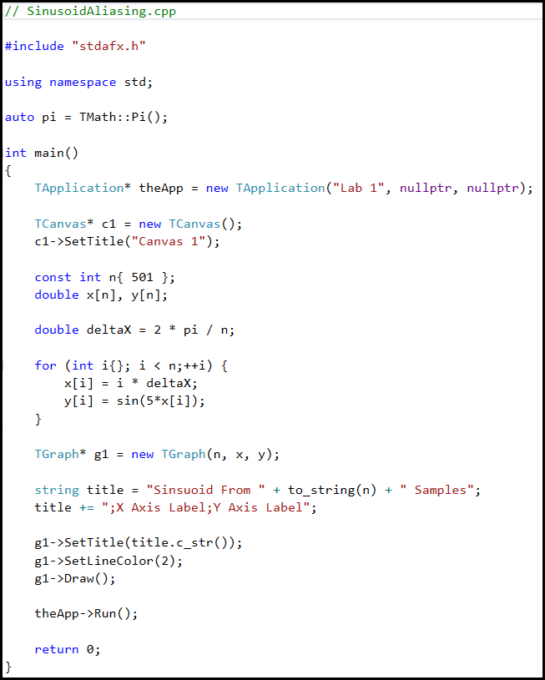
Lab 1
auto
TMath::Pi()
TApplication*
new()
nullptr
TCanvas*
-> operator
deltaX
period of wave
TGraph*
string
to_string()
title.c_str()
theApp->Run()

Slide 15
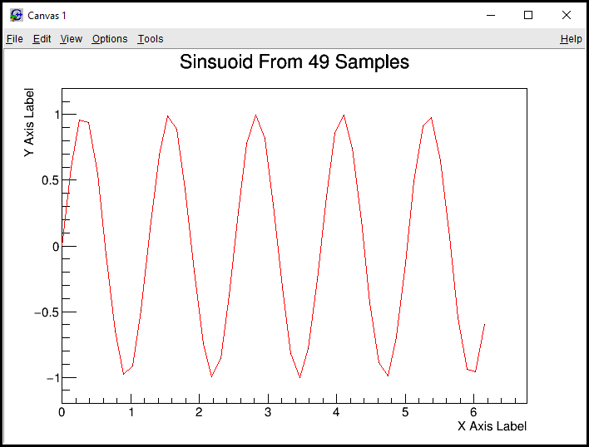
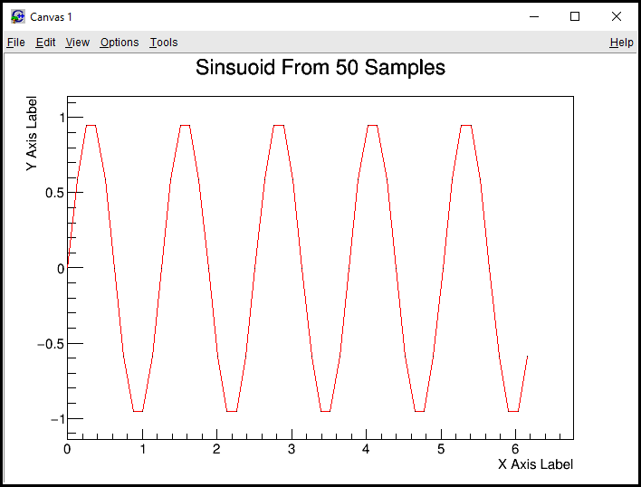
Lab 1 – Sinusoid Aliasing
What happens to the curve when the GCD(number of intervals, fundamental harmonic) > 1?
What can be done to n minimize this effect?

Slide 16
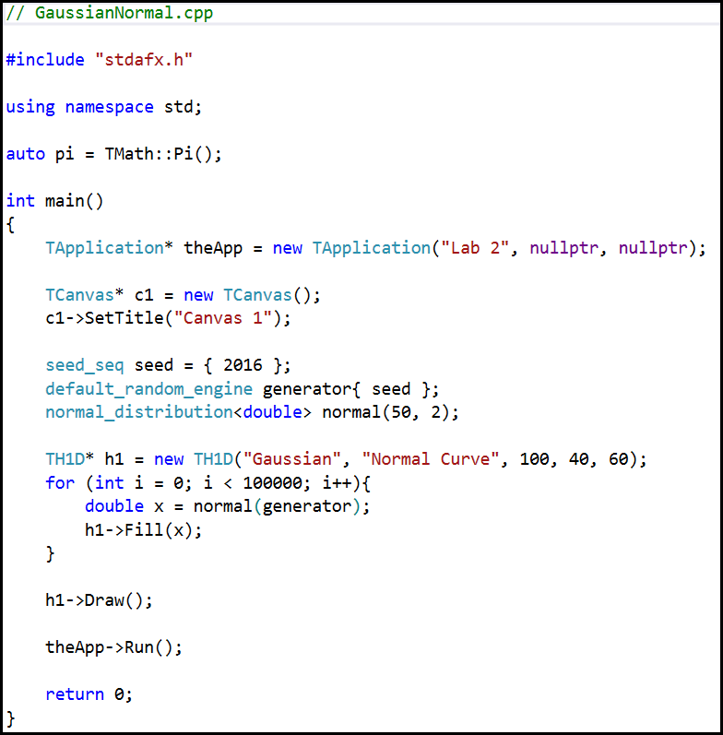
Lab 2
seed_seq
default_random_engine
normal_distribution
TH1D*
Histogram, 1D, double
h1->Fill()

Slide 17
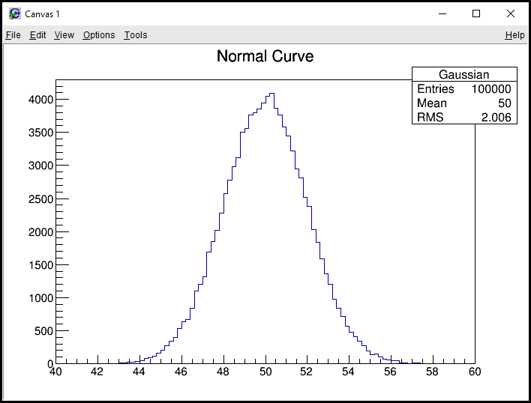
Lab 2 – Gaussian Normal
What happens to the curve as we increase the number of samples (i)?
What happens as you increase the standard deviation?

Slide 18
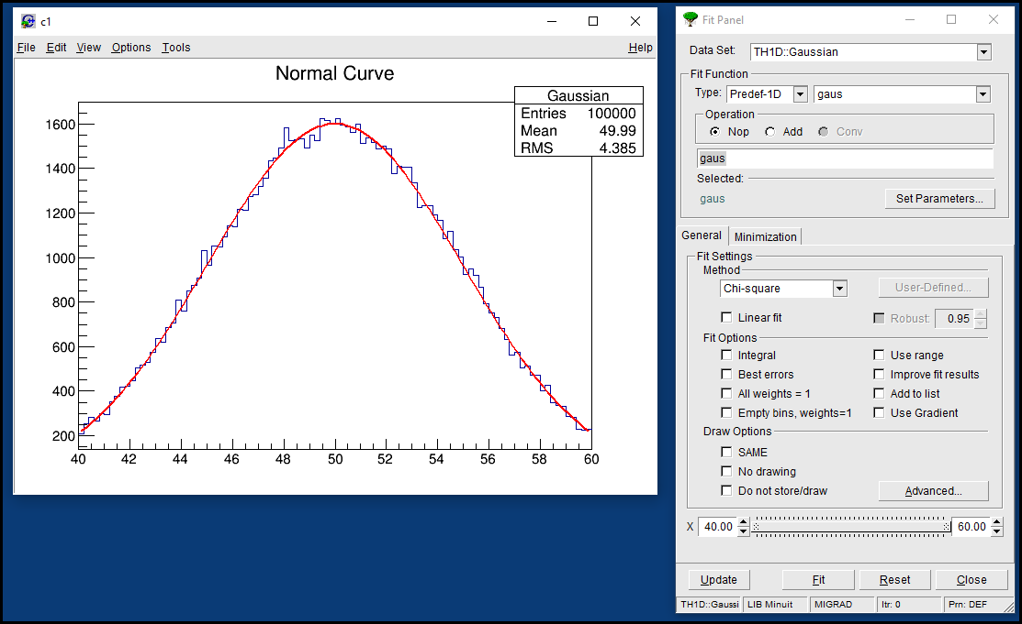

Slide 19
Now you know…
ROOT is a set of open-source C++ libraries developed by a team of scientists at CERN
ROOT is heavily used across the BNL – most science posters you see hung on the walls throughout the lab contain complex graphs developed in ROOT
It would be very beneficial to develop skills with ROOT and to reference those skills on any internship application in DOE
To minimize aliasing (data loss) it is best to sample that data at a rate which is coprime to the fundamental harmonic (period) of a waveform
A normal probability distribution spreads out (flattens out) as its standard deviation increases

